Slide 1




HBL Workshop
Apple AADC programme
Handover of Documents For PGI
Harbourlink Whse
16/06/2011
As‘at Bin Rasul

Slide 2


Content
PLAN
Pg 3-6
Workshop Charter
Agenda
Floor Plan
ACT
Pg 16-21
To-do-List
5S
After pictures
CHECK
Pg 15
SOP
DO
Pg 7-14
Before pictures
TIMWOOD
Fishbone Diagram
Six Improvement Questions
DB Schenker | Corporate Contract Logistics/SCM & Efficiency Management, 08.11.26
Notes:
The Content-Charts needs to be adjusted manually:
The above listed charts form the basis of the project documentation
Further charts can be included at desired places of the documentation and must be added in the Content-Chart.
Placeholders exist in every phase (>>Fill in text<<); please delete or overwrite these placeholders

Slide 3
Overview PLAN
P
D
C
A
Content
Mandatory tools
Optional tools
Describe problems and goals
Brainstorm for solutions
Decide on best solutions
Workshop Charter
Agenda
Floor Plan
Timwood
Fishbone Diagram
DB Schenker | Corporate Contract Logistics/SCM & Efficiency Management, 08.11.26
Notes:
Handling of template:
Chart gives an overview regarding next phase and serves as separator.

Slide 4
Workshop Charter
Mandatory
Problem description:
On-line store personnel have to take unnecessary time and effort to walk from their workstations to the office to hand in every DN’s which they have complete scanning. Admin will then PGI the order once they rec’d the DN.
Focus in:
Apple Online Store
Focus out:
Incoming Area
Goal description:
To have a checkbox function in the on-line scan pack summary system so that when an order has been completed, he/she can directly tick the checkbox so as to notify the admin staff that the order are ready for shipment and to be PGI.
Target set by 30/06/2011
5’s’ POP Responsible
Asat Rasul, George Lim & Peter Lim
Team members:
Michelle Chan
Eliza Tay
Cherie Ong
Kenzi
Ferdinand
5 ‘s’ Facility Sponsor
Roger Quek
DB Schenker | Corporate Contract Logistics/SCM & Efficiency Management, 08.11.26
Notes:
Handling of the Template::
Please delete or overwrite all comments
The textboxes need to be filled during the following phases:
Problem description, goal description, team members, monetary benefit, signature sponsor and controlling:
Predefinition before Kick-off
Adjustment and confirmation during Kick-off with team and sponsor
Customer benefit, defects, focus in, focus out: during definition phase
Monetary Benefit
Please delete irrelevant „Types of Potential“ (no placeholders)
Type 1 Potential reflects the monetary benefit, which becomes part of the P&L (Profit and Loss) Statement. In case of any uncertainties, please contact your regional Controller
Type 3 Potential reflects the monetary benefit, which does not become part of the P&L (Profit and Loss) Statement. In case of any uncertainties, please contact your regional Controller
Type 4 Potential reflects all further benefits (Soft-savings). This includes all savings which can not be evaluated monetarily, as for instance: delay time [Minutes], reduction in labour costs without monetary effects (no or delayed consideration in Controlling-Systems). When speaking about reduction in staff the „DispoKosa“ has to be used and the result should be considered as Soft-savings.
Type 2, 5 and 6 Potential should be transformed into measurable Potentials (if possible). In exceptional cases the not-measurable benefit can be formulated in prose (e.g. legal certainty, ...)

Slide 5
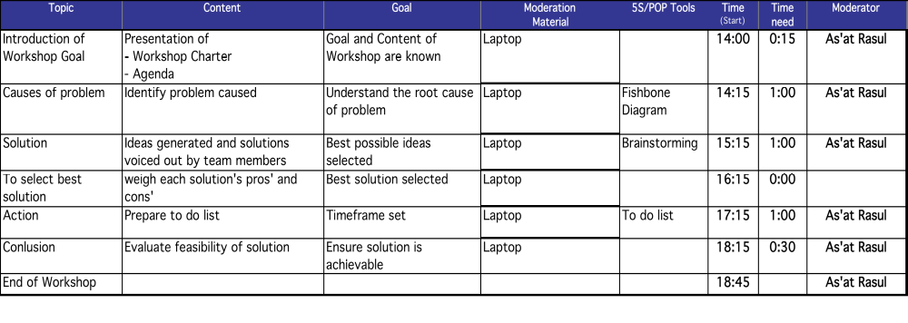
Agenda
Mandatory
DB Schenker | Corporate Contract Logistics/SCM & Efficiency Management, 08.11.26

Slide 6
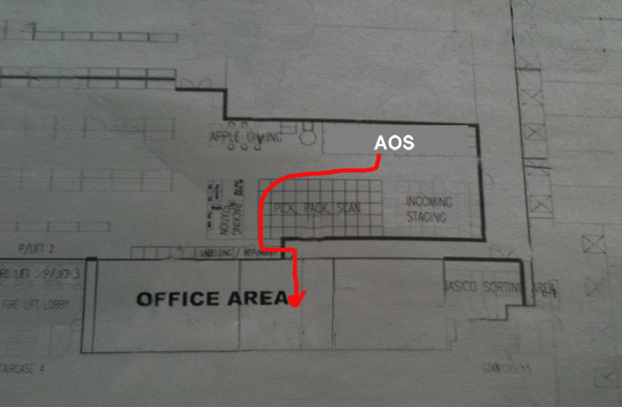
Floor plan of the facility
Mandatory
DB Schenker | Corporate Contract Logistics/SCM & Efficiency Management, 08.11.26

Slide 7
Overview DO
P
D
C
A
Content
Mandatory tools
Optional tools
Discuss with the team
Identify root cause to the problem
Come up with best possible solutions to improve on the current situation
TOOLS FOR FINDING
SOLUTIONS
Brainstorming
6 Improvement Questions
Before – After Picture
DB Schenker | Corporate Contract Logistics/SCM & Efficiency Management, 08.11.26
Notes:
Handling of template:
Chart gives an overview regarding next phase and serves as separator.

Slide 8
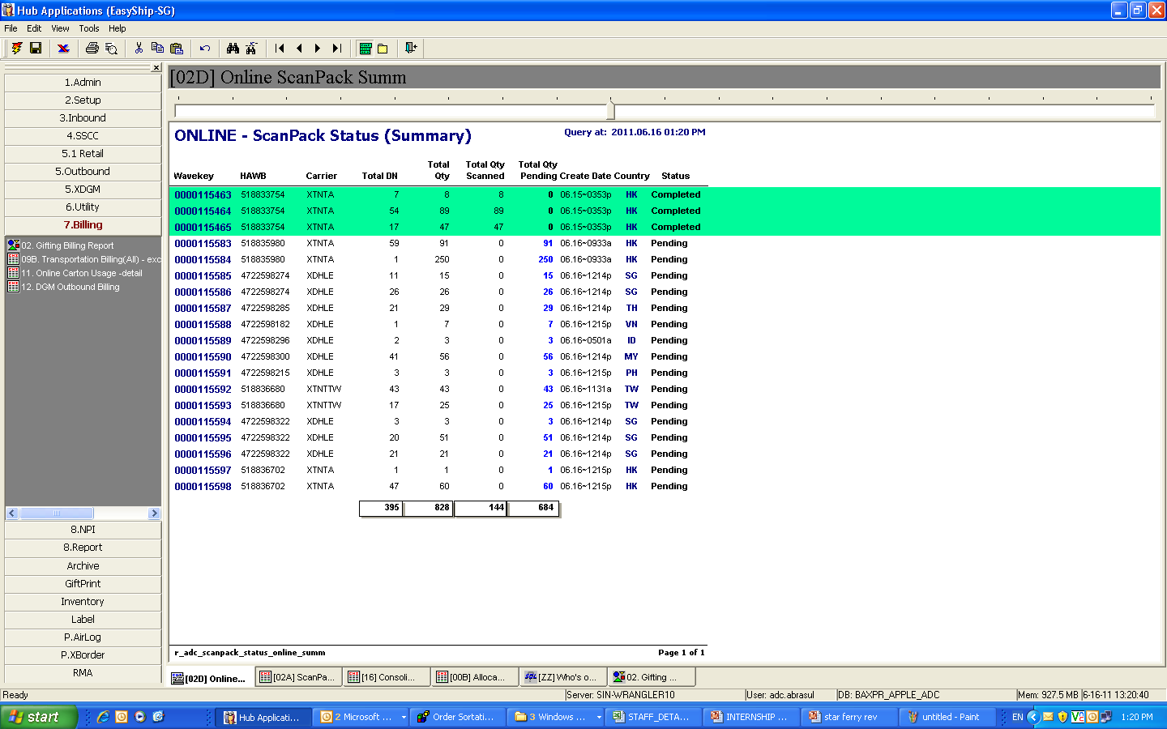
Before Implementation
System completed, but Admin team unable to determine if the order is ready to be PGI. Reason maybe due to label not printed out, manifest discrepancy or etc…
DB Schenker | Corporate Contract Logistics/SCM & Efficiency Management, 08.11.26

Slide 9
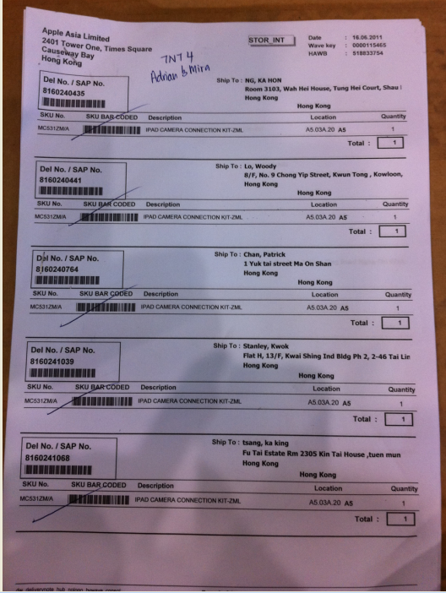
Delivery Note
Current situation: Storekeeper after complete scanning and confirm no discrepancy encounter will then pass the DN to Admin team to proceed with the PGI.

Slide 10
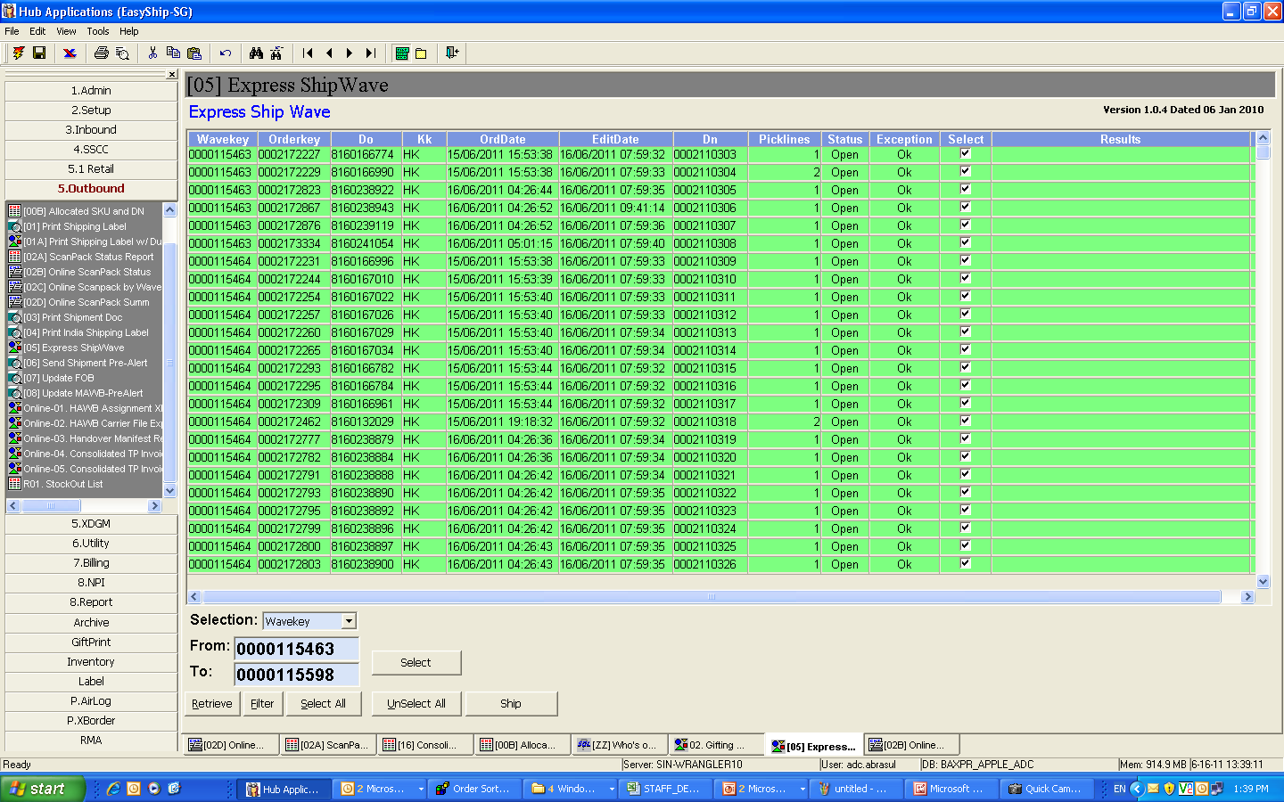
After - PGI ON PROCESS AFTER DN IS SUBMITTED
Admin team upon received the DN from the on-line personnel will then proceed to PGI. Admin will select the order in the system. Then PGI done (Shipped)

Slide 11
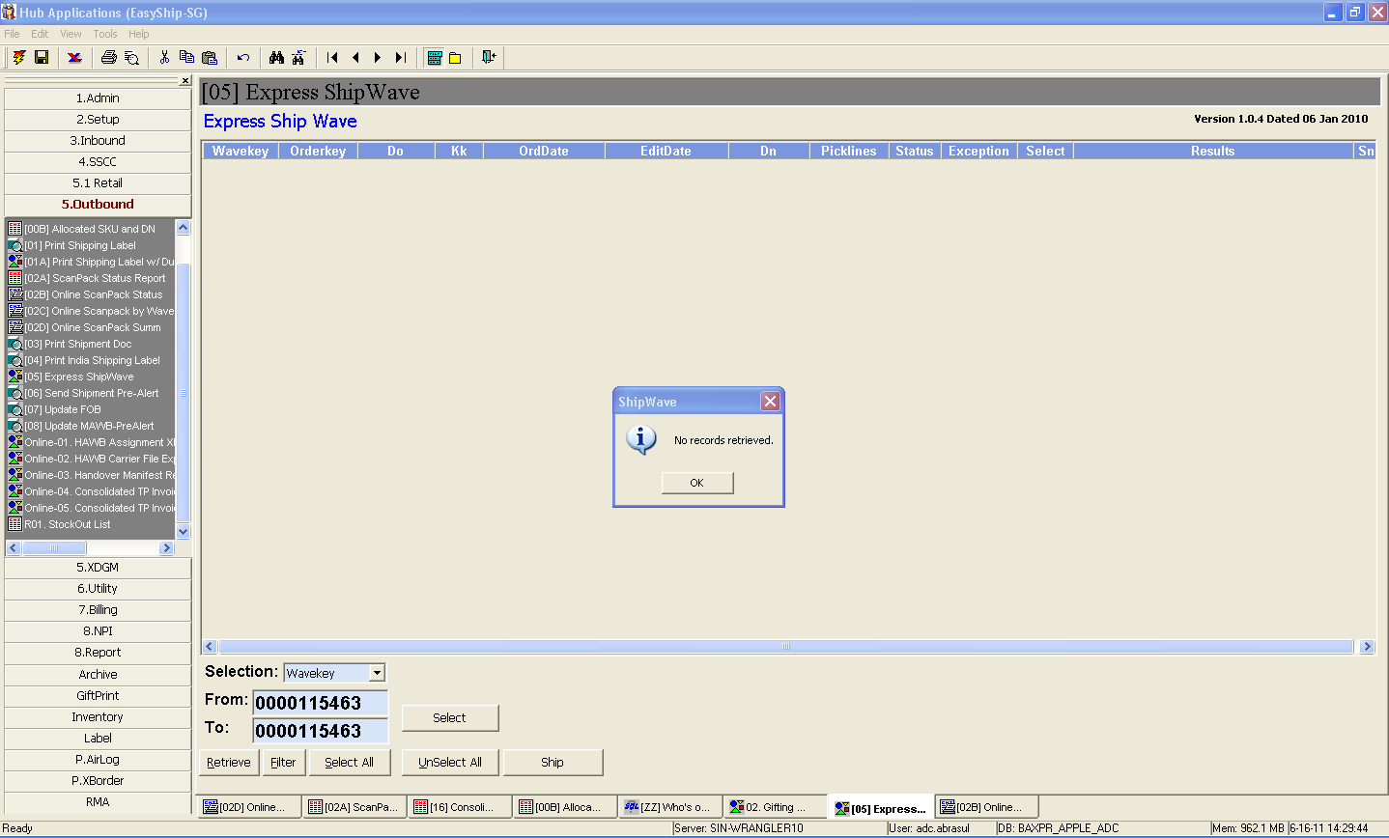
PGI COMPLETED. ORDER SHIPPED

Slide 12
Collect wastes
T
Extra walking distance for logistic assistant
I
Nil
M
Admin staff do double checking that all DNs are complete
W
.
Admin staff have to wait for handover of documents
O
Nil
O
Nil
D
Logistic assistant have to collect back document in case of discrepency
DB Schenker | Corporate Contract Logistics/SCM & Efficiency Management, 08.11.26
Notes:
Handhaben der Vorlage:
nicht benötigte Felder anklicken und löschen
Textfeld ist für max. zwei Zeilen ausgerichtet
Möglichst kurz fassen
Unklare Aspekte vorerst auf Rahmen positionieren (am Ende der D-Phase müssen diese geklärt sein)

Slide 13


Potential Causes – Fish Bone Diagram
Man
Machine
Extra walking effort made
Frequencies of interaction between logistic & admin staff
Double checking of DNs on the system
Tiredness from walking
Computer might hang at times
Excess walking from AOS to admin office
Waste time writing down details required
Admin have to double check if all are scanned
Sorting of DNs for future reference
Waste storage space
Paper left cluttered on admin desk
Wastage of staple bullets
Method
Material
DB Schenker | Corporate Contract Logistics/SCM & Efficiency Management, 08.11.26
Notes:
Handling of template:
Double click table and edit table like an Excel-table (the Excel-Menu appears on top).
In case of bifurcation (e.g. multiple VOC’s are summarised to one key issue) leave fields blank and colour bifurcations alternating in grey and white (see example)
How to colour grey/white: mark at first fields in the table, use path: Format>Rahmen (German version) and Schattierung>Schattierung>Grau25% resp. without
Click somewhere outside the Word-window for closing the Word-table.
Edit enumeration.
Copy causes from Cause-Effect-Diagram
Starting from causes, try to figure out why the input measurement responds like this and not differently. Try to identify the root causes by further asking „Why“-Questions.
You do not necessarily have to ask 5 times „Why“. It is sufficient to end at a level on which the problem can be solved.
Example:

Slide 14
Potential Solutions:
Six improvement questions
T
Who
What
Where
Logistic assistant that are in charge of AOS
To include a checkbox system inside the computer
Brainstorming
Admin office
Apple AOS work Area
I
M
W
When
Why
How
O
2011
To minimise time wastage
More productivity
To increase efficiency
Ensure workers know how to handle the system
Ensure that system will not slow down the rest of the programs
O
D
DB Schenker | Corporate Contract Logistics/SCM & Efficiency Management, 08.11.26

Slide 15
Overview CHECK
P
D
C
A
Content
Mandatory tools
Optional tools
Ensure that no errors are made when carrying out plan
Ensure that correct steps are followed
Improvise on existing solutions when needed
Request for additional feedback from staff
Step by Step
Standard of procedures to ensure that orders completed before using checkbox
DB Schenker | Corporate Contract Logistics/SCM & Efficiency Management, 08.11.26
Notes:
Handling of template:
Chart gives an overview regarding next phase and serves as separator.

Slide 16
Overview ACT
P
D
C
A
Content
Mandatory tools
Optional tools
Implement agreed solution and set-up implementation plan
To-do-List
DB Schenker | Corporate Contract Logistics/SCM & Efficiency Management, 08.11.26
Notes:
Handling of template:
Chart gives an overview regarding next phase and serves as separator.

Slide 17
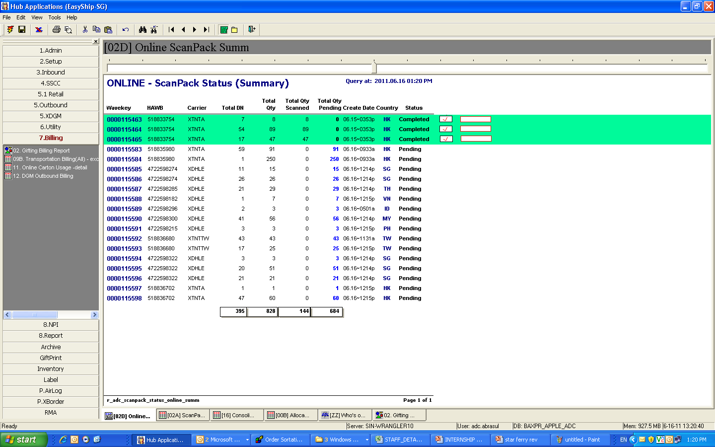
After Implementation
Mandatory for 5S
With Check Box
AOS will tick the checkbox once he/she has completed the order. Admin team will then able to determine that the order has no discrepancy once the checkbox is ticked and will proceed with the PGI without waiting for the DN to be submitted.
DHL 3 IP 150
DHL 2 IP 151
DHL 1 IP 152
DB Schenker | Corporate Contract Logistics/SCM & Efficiency Management, 08.11.26

Slide 18
After - PGI ON PROCESS AFTER DN IS SUBMITTED
Admin team will proceed with the PGI once the checkbox is ticked. No more waiting for the DN to be submitted. Admin will select the order in the system. Then PGI done (Shipped)

Slide 19
PGI COMPLETED. ORDER SHIPPED

Slide 20
To-Do-List
Mandatory
Workshop: Apple AADC
Date: 16/06/2011
no.
Cause to Problem
Activity for solution
Responsible
Until
Status
Notes
1
Tiredness from frequent walking to admin office
Tick the checkbox once scanning is completed
Ye Min Yi
Asat
30/06/2011
…
2
2
Waiting time for the admin staff
Implement of a checkbox in the system
…
Ferdinand
Peter Lim
30/06/2011
…
DB Schenker | Corporate Contract Logistics/SCM & Efficiency Management, 08.11.26

Slide 21
Sort
Mandatory for 5s
To remove unnecessary process and steps so as to achieve higher productivity and efficiency.
Before Implementation
1 DN spend about 2 mins from operation to office. Average Per day @ 50 DNs.
50 DNS X 2MINS = 100MINS
After implementation,
Admin team able to PGI without waiting for the document.
Eliminate the waste of walking timing from operation to office.
Productivity gained.
Time save @100 mins daily.
DB Schenker | Corporate Contract Logistics/SCM & Efficiency Management, 08.11.26

